Slide 1
Accelerate Image Processing Using FPGA Hardware

Slide 2
Learning Outcomes
At the end of this module, you will be able to:
Explain the purpose of hardware acceleration and give examples of its implementation.
Give examples on how to modularize hardware to achieve hardware acceleration.
Compare and contrast the advantages and disadvantages of hardware acceleration vs using Neon technology.

Slide 3
Parallel Image Processing
Pixel 1
Step A
Pixel 1
Step B
Pixel 2
Step A
Pixel 2
Step B
Input
…
…
Output
Pixel 1
Step A
Pixel 1
Step B
SIMD processor
DSP
GPU
Customized logic
Pixel 2
Step A
Pixel 2
Step B
Input
Output
…
…
Pixel N
Step A
Pixel N
Step B
Notes:
In the previous chapter, we have completed our SoC design and demonstrated it using an edge detection image-processing application. We might also see that there are limitations when implementing image processing in sequential software.
To improve the performance, image data is better to be processed in parallel.
Today most of the image-processing job is done by SIMD processor, DSP, GPU, or customized hardware circuits.

Slide 4
Hardware Acceleration
Hardware acceleration is the use of hardware to perform some functions instead of running on a general-purpose CPU.
The hardware is designed for specific functions to increase performance and/or reduce resource consumption.
It is a tradeoff between flexibility and efficiency.
Examples of hardware acceleration:
GPUs
Fixed-function implemented on FPGAs
Fixed-function implemented on ASICs

Slide 5
Example of Hardware Acceleration
Graphics Processing Unit (GPU) is one of the well-known examples of hardware acceleration.
The name GPU was popularized by Nvidia in 1999. Before that, some implementations of graphics display accelerator had been used in PCs and game consoles.
Nowadays, GPUs become usually one of the top 2 computing modules in computers and mobile devices to perform 2D and 3D graphics. Considering the parallel computing ability of GPUs, they are even used to do general-purpose computing.

Slide 6
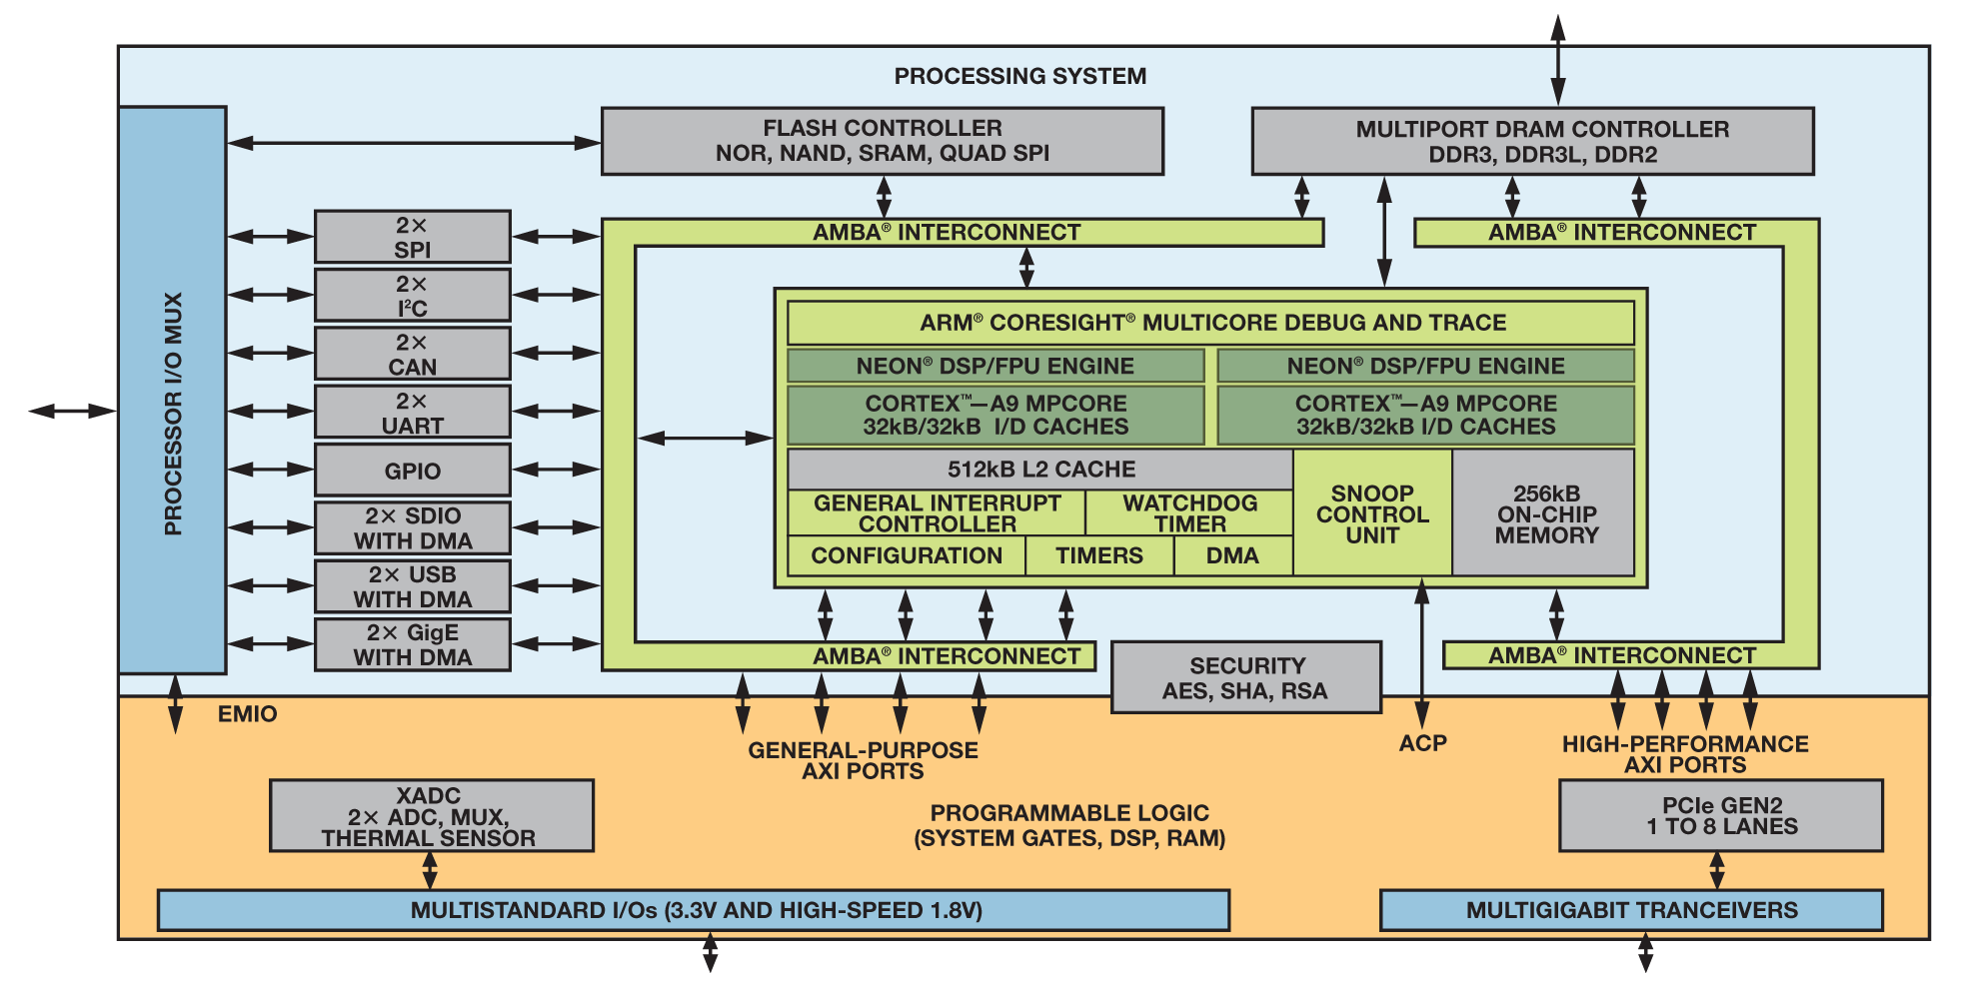
Zynq-7000 Platform

Slide 7
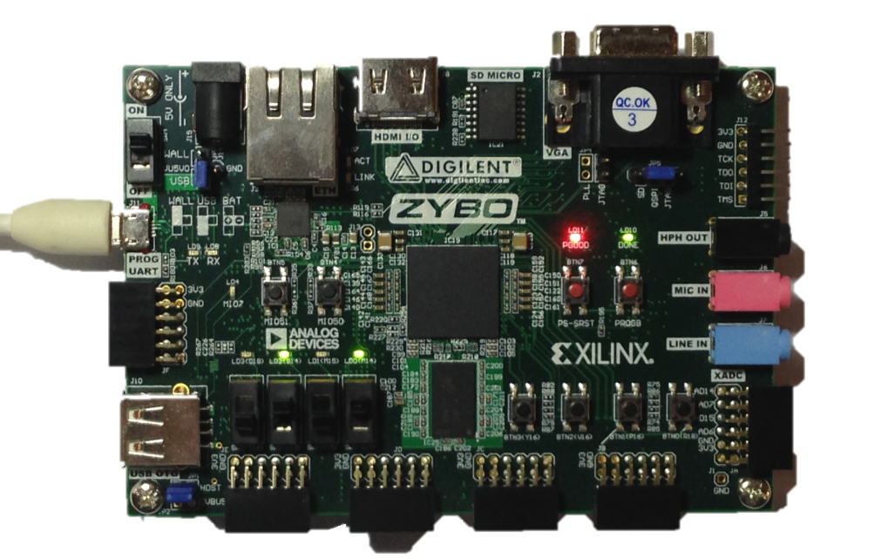
FPGA on Zynq platforms
Zynq specifically integrates Arm Cortex CPUs and Xilinx FPGAs
Need of description and connection between CPUs and FPGAs
AXI protocol is one of the standard protocols for bus connections
Increase the re-usability and lead to low development cost
AXI4 protocol (Advanced eXtensible Interface 4)
4th generation of Arm AMBA (Advanced Microcontroller Bus Architecture) interface standard
Provide high-bandwidth, low-latency, highly flexible design for various components and requirements
For re-usability and scalability

Slide 8
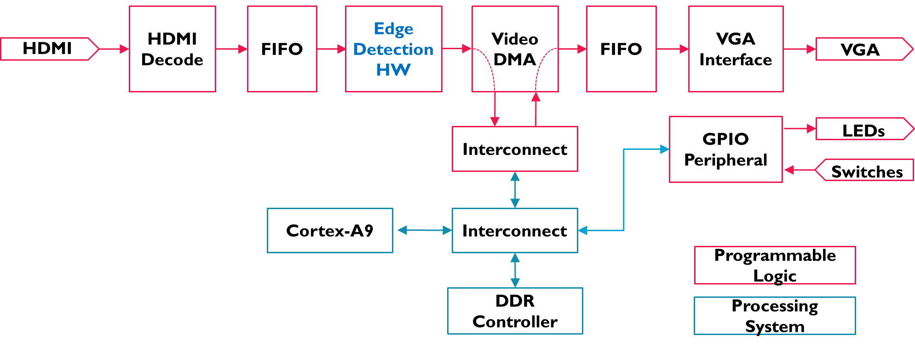
Offload Image-Processing Algorithm from CPU to FPGA
HDMI decode
HDMI output peripheral
HDMI
Notes:
We’re going to design newly added edge detection module into the FPGA fabric

Slide 9
Modularize Hardware
AXI4-Stream
Edge Detection HW
AXI4-Stream
modularize
s_axis_tdata[23:0] (RGB pixels)
s_axis_tdata[7:0] (Intensity pixels)
s_axis_tdata[23:0] (edge pixels)
Intensity kernel
Stencil
Buffer
Memory
Stencil_pixels[7:0]x8
Edge
Kernel
Stencil Edge Kernel
Video Stream Processing
AXI4 Stream protocol would be suitable
Using a standard protocol leads to design re-usability
We split “Edge Detection HW” into two(or three) modules
Intensity kernel (computes intensity of each pixel, or converts RGB pixels to grey-scale ones)
Stencil Edge Kernel (computes edge values of specific pixels)
Stencil Buffer Memory (buffers intensity of each pixel)
Edge Kernel (actual kernel for edge values)

Slide 10
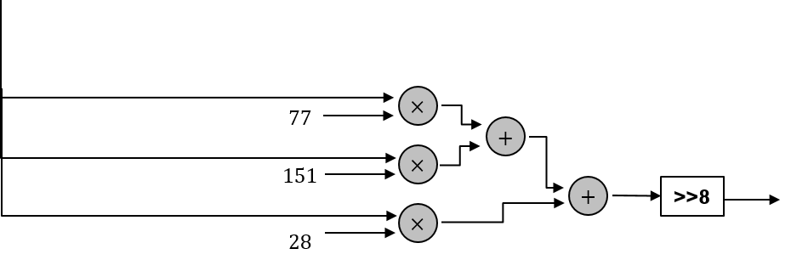
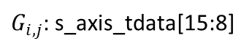
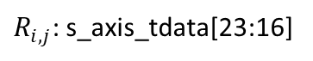
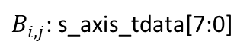
1st Module: Intensity kernel
s_axis_tdata[23:0] (RGB pixels)
$R_{i,j}$: s_axis_tdata[23:16]
$G_{i,j}$: s_axis_tdata[15:8]
s_axis_tdata[7:0] (intensity pixels)
$B_{i,j}$: s_axis_tdata[7:0]
s_axis_tvalid
m_axis_tvalid
s_axis_tuser
Finite State Machine & Controller based on AXI4-Stream protocol
m_axis_tuser
s_axis_tlast
m_axis_tlast
s_axis_tready
m_axis_tready
Pipeline structure for intensity computation
In our design, we get an intensity pixel per cycle after 5cycle latency
Separate data path and control path

Slide 11
1st Module: Intensity kernel - Pipeline
s_axis_tdata[23:0] (RGB pixels)
$R_{i,j}$: s_axis_tdata[23:16]
$G_{i,j}$: s_axis_tdata[15:8]
s_axis_tdata[7:0] (intensity pixels)
$B_{i,j}$: s_axis_tdata[7:0]
In our design, we put pipeline register in the above dotted line
5 pipeline registers lead to 5 cycle latency
# of pipeline registers could be reduced in accordance with clock frequency

Slide 12
2nd Module: Stencil Edge Kernel
s_axis_tdata[7:0] (Intensity pixels)
s_axis_tdata[23:0] (edge pixels)
Stencil
Buffer
Memory
Stencil_pixels[7:0]x8
Edge
Kernel
Stencil Edge Kernel
Split “Stencil Edge Kernel” Module into two smaller modules to separate functions (buffering & computation)
Stencil Buffer Memory is useful for Stencil Kernel i.e. Stencil computation in stream processing

Slide 13








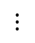


Stencil Computing
Computation involving 8 neighboring pixels is called “Stencil Computation”
0
1
2
3
4
5
$$⋯⋯⋯$$
1277
1278
1279
1280
0
1
2
$$⋯⋯⋯$$
3
4
$$⋯⋯⋯$$
5
$$⋮$$
$$⋮$$
$$⋮$$
$$⋱$$
$$⋮$$
$$⋮$$
717
718
$$⋯⋯⋯$$
719
720
$$⋯⋯⋯$$

Slide 14
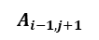
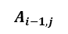

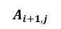
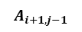

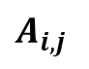
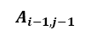


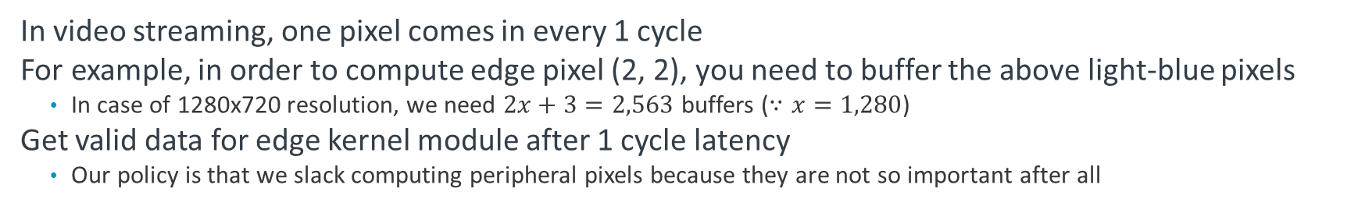
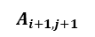
2-1st Module: Stencil Buffer Memory
$x+1$ buffers
$x+1$ buffers
s_axis_tdata[7:0] (Intensity pixels)
$$A_{i+1,j+1}$$
$$A_{i−1,j+1}$$
$$A_{i+1,j}$$
$$A_{i,j}$$
$$A_{i−1,j}$$
$$A_{i+1,j−1}$$
$$A_{i−1,j−1}$$
do_22
do_21
do_20
do_12
do_10
do_02
do_01
do_00
1
2
3
4
5
$$⋯⋯⋯$$
1277
1278
1279
1280
1
do_00
do_01
do_02
2
do_12
$$⋯⋯⋯$$
do_10
3
do_20
do_21
do_22
In video streaming, one pixel comes in every 1 cycle
For example, in order to compute edge pixel (2, 2), you need to buffer the above light-blue pixels
In case of 1280x720 resolution, we need $2x+3=2,563$ buffers ($∵x=1,280$)
Get valid data for edge kernel module after 1 cycle latency
Our policy is that we slack computing peripheral pixels because they are not so important after all

Slide 15
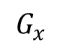
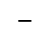

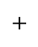
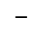
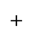

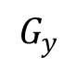
2-2nd Module: Edge Kernel
Edge Kernel
do_02
$$+$$
do_12
$$G_{x}$$
Look at eq(2)&(3) in slide No.8
do_22
$$+$$
$$−$$
$$×$$
do_00
do_01
do_02
do_00
$$+$$
s_axis_tdata[7:0] (edge pixels)
do_10
$$+$$
do_12
do_20
$$+$$
>>4
do_10
do_20
$$+$$
do_21
$$G_{y}$$
do_20
do_21
do_22
do_22
$$+$$
$$−$$
$$×$$
do_00
$$+$$
do_01
$$+$$
do_02
s_axis_tvalid
m_axis_tvalid
s_axis_tuser
Finite State Machine & Controller based on AXI4-Stream protocol
m_axis_tuser
s_axis_tlast
m_axis_tlast
s_axis_tready
m_axis_tready
Pipeline structure for intensity computation
In our design, we get an edge pixel per cycle after 8cycle latency
Separate data path and control path

Slide 16
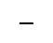
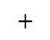
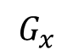
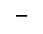
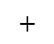
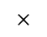
2-2nd Module: Edge Kernel - Pipeline
Edge Kernel
do_02
$$+$$
do_12
$$G_{x}$$
do_22
$$+$$
$$−$$
$$×$$
do_00
$$+$$
s_axis_tdata[7:0] (edge pixels)
do_10
$$+$$
do_20
$$+$$
>>4
do_20
$$+$$
do_21
$$G_{y}$$
do_22
$$+$$
$$−$$
$$×$$
do_00
$$+$$
do_01
$$+$$
do_02
In our design, we put pipeline registers in above dotted line
8 pipeline registers lead to 8 cycle latency
# of pipeline registers could be reduced in accordance with clock frequency
Some operations deal with bit width adjustment, data saturation and you name it

Slide 17
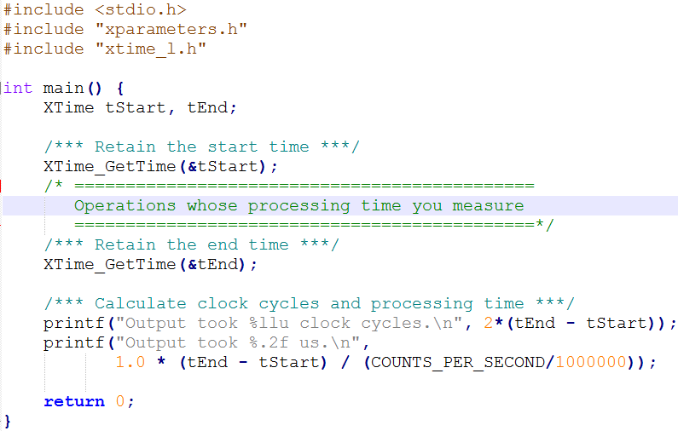
Performance Measurement
Global timer embedded in Zynq can be used to measure the computing time consumption.

Slide 18
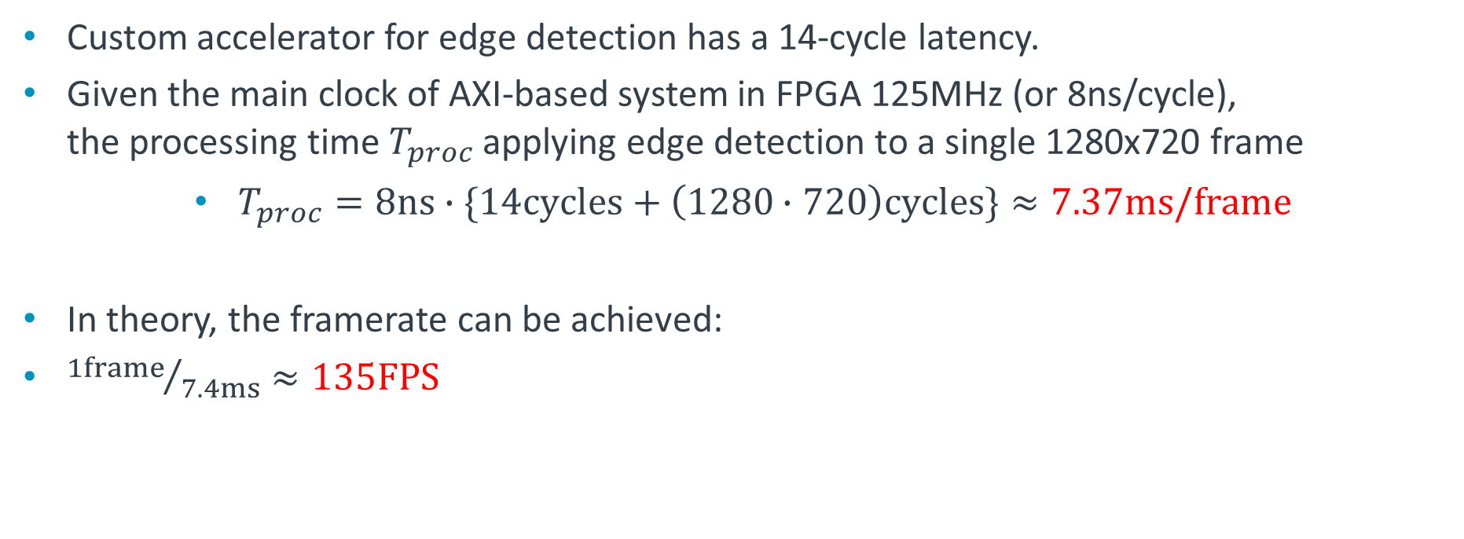
Performance Measurement
Custom accelerator for edge detection has a 14-cycle latency.
Given the main clock of AXI-based system in FPGA 125MHz (or 8ns/cycle), the processing time $T_{proc}$applying edge detection to a single 1280x720 frame
$T_{proc}=8ns∙\{14cycles+\left(1280∙720\right)cycles\}≈7.37ms/frame$
In theory, the framerate can be achieved:
${1frame}/{7.4ms}≈135FPS$

Slide 19
Custom Hardware Resource Utilization
Module | LUTs (17,600) | Registers (35,200) | BRAMs (60) | DSPs (80)
Whole | 5,090 (29.0%) | 7,085 (20.2%) | 16.5 (27.5%) | 0
VDMA | 2,595 | 3,441 | 14 | 0
Edge Detect HW | 1,079 | 1,771 | 0 | 0
Total utilization of LUTs, Registers, and BRAMs is approx. 20-30%
VDMA is responsible for almost or more than the half of it
Custom accelerator ‘edge_detect_hw’ takes up less than 25% of the overall system with respect to LUTs and registers.

Slide 20
Neon vs. FPGA Offload
Neon advantages – Easy programming & debug – Fully coherent with CPU, no cache maintenance operations – Part of Arm arch - no hardware or software integration required – Ecosystem support off-the-shelf, no porting required
FPGA advantages – Runs parallel with CPU, few CPU cycles required – More ‘real time’ - no OS/cache variability – Fixed function or limited codec support – Potentially higher performance (e.g. 1080p Full HD video)

